Slide 1
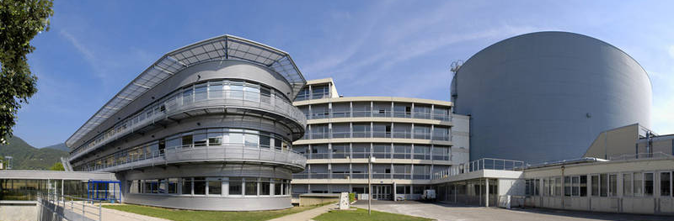

The ILL Joins the Mantid Project
Dr Ian Bush, Dr Gagik Vardanyan, Mrs Verena Reimund, Dr Antti Soininen, Dr Miguel Gonzàlez
NoBugs – 18th October 2016
Notes:
Thank you for the introduction.
So I am going to talk about the ILL’s project to adopt the Mantid Framework. I’ll say a bit about the project and people involved at the ILL and working with our partners in the distributed team.
I will show the differences and similarities between LAMP and Mantid, and the reasons for choosing the Mantid Framework. I will then talk about some work for Time-of-Flight spectroscopy and Backscattering workflows at the ILL, and I will finish up by talking about future work at the ILL.

Slide 2
Talk Overview
Mantid and Adoption at the ILL
Working with the Mantid Team
LAMP and Mantid for Data Reduction
Workflows
Time-of-Flight Spectroscopy
Backscattering
Future Work
Notes:
(As bullet points)

Slide 3


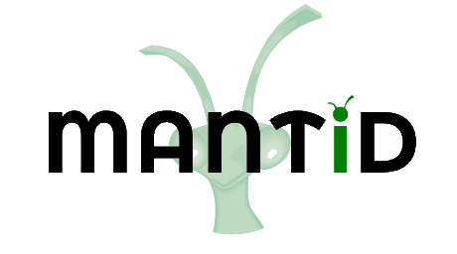





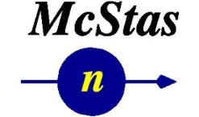

The Mantid Project – Neutron Data Reduction
Notes:
Mantid was quite nicely introduced yesterday, but in short it is a framework to support neutron data reduction.
The project started at ISIS, the SNS have been members for some time now, and the ESS have also joined the project. There are also a number of contributing institutions to the Mantid code. This where ILL has been previously, some work being done as a proof of concept for using Mantid, but now we are signing up as full partners.

Slide 4

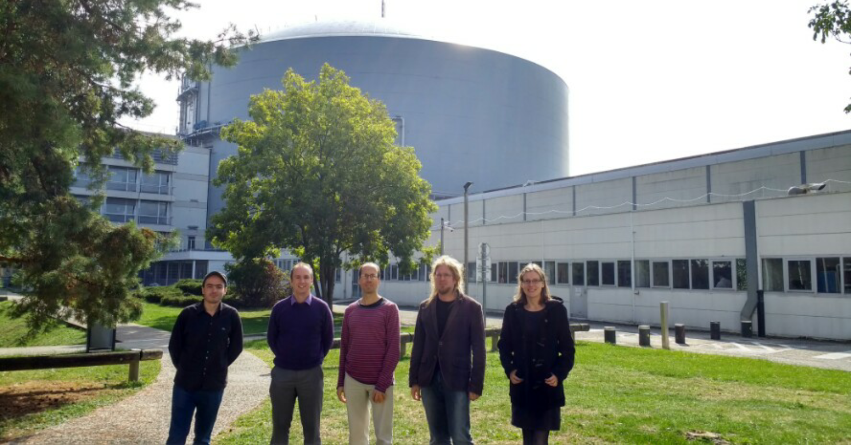
The Bastille Project for Mantid Adoption
Bastille project, part of ILL’s Endurance programme, to support 20 ILL instruments after 3 years, replacing LAMP
People involved:
Antti Soininen, Verena Reimund, Gagik Vardanyan
Ian Bush – technical lead for one year – from Tessella
Miguel Gonzàlez – scientific lead for the project – from ILL’s CS Group
Notes:
The Bastille project is part of ILL’s Endurance programme. The Endurance programme has a number of scientific aims, such as instrument upgrades and sample environment improvements. The Bastille project in Endurance is an effort to improve data reduction and analysis – this is an important project for the ILL as data processing has not always been given sufficient attention in modernisation programmes, yet it is of crucial importance in the scientific pipeline. A large component of this is for Mantid adoption.
3 new developers, brand new to the Mantid project. Antti has been working at MLZ for the three years prior to joining the ILL. Verena has a background in electrical engineering and C++ development, while Gagik recently finished his PhD at CERN. Gagik was originally meant to give this talk, but he unfortunately could not make it, so I am giving it in his place.
Then there is myself, who is the technical lead for the project, from Tessella, who has worked on Mantid at previously.
Finally there is Miguel Gonzalez, who has been based at ILL for a number of years, and has developed Lamp, ILL’s existing data reduction package. So Miguel is the scientific lead for the project, with the knowledge of the existing data reduction approach at the ILL.
https://www.ill.eu/de/about/zukunftsplaene/endurance/the-endurance-projects-june-2013/

Slide 5





Working with Distributed Partners
Notes:
Integrating with the rest of the Mantid team has been made a lot eaiser through using the right tools. There is of course nothing better than meeting face to face, but other than at events like this one, it is difficult to do.
GitHub is used for version control, but the PR system is also great for remote working. It makes code reviews easy even in the situation where you could not sit down and talk to some about it.
Using Jenkins makes it easy to verify the pull requests pass the unit tests and static analysis checks, and pass on all platforms. It means we do not have to worry about setting up builds for all the supported platforms at ILL straight away. The integration between Jenkins and GitHub makes the checks very easy to keep track of.
Slack is used for the day-to-day communication, and makes it easy to talk to someone about a piece of code, or ask questions of the whole team.
Finally, the usual video conference tools for things like the Mantid review meetings and meetings for the technical steering committee are the closest we get to the regular face-to-face meetings.
PR reviews are a good example of these tools interacting together. Those of us working at the ILL pick up tickets from the other parntners to review, and, as well as sharing our own knowledge means we can pick up more about different aspects of the code base we come across.
Starting out was a good example of using these tools, the new starters at ILL ran through some training exercises, opened PRs on GitHub, checked by Jenkins. Then we had meetings via Skype to discuss some of the exercises, and followed up with a few changes discussed on Slack.

Slide 6
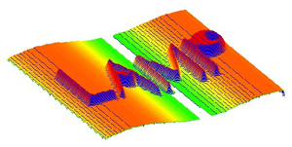
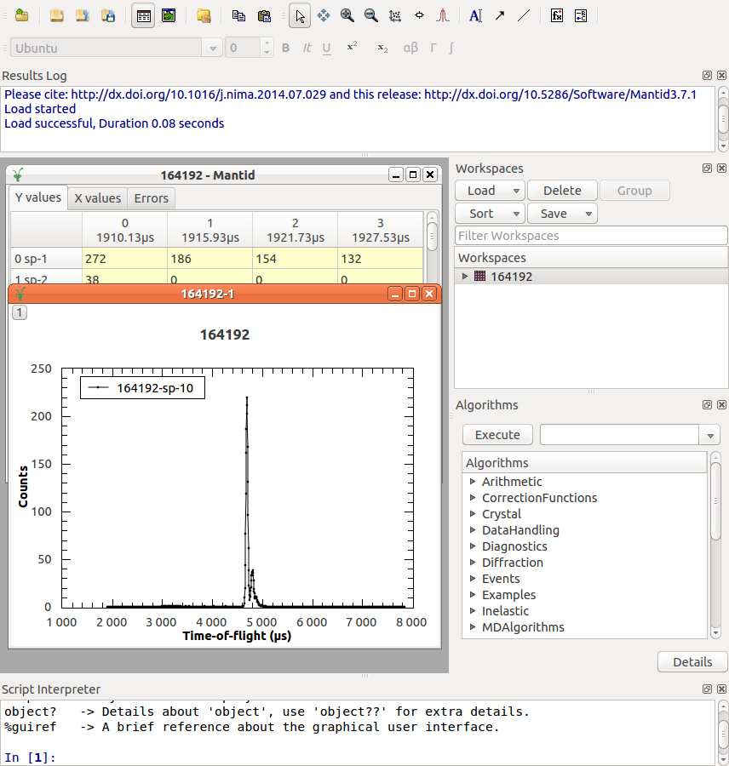
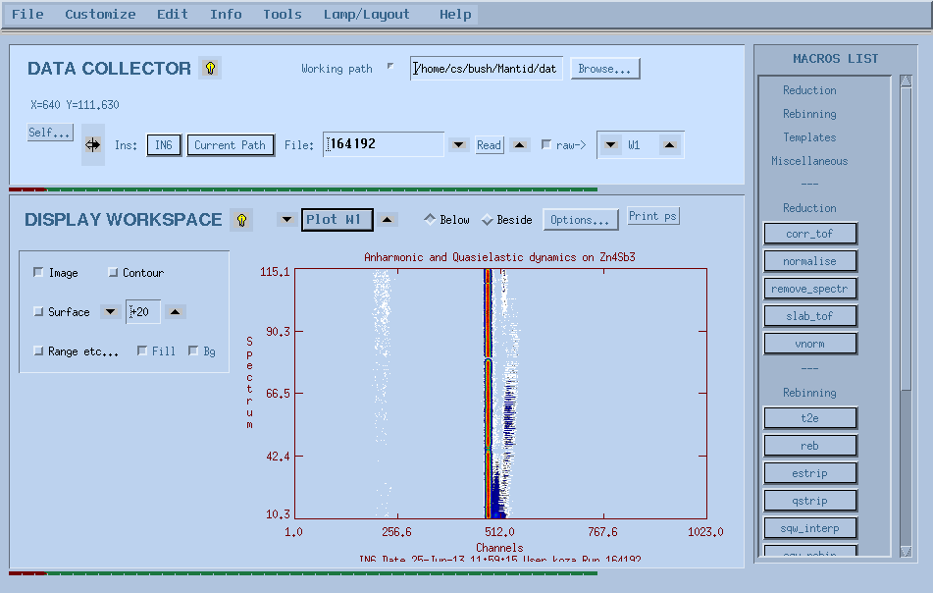
LAMP and Mantid
Notes:
I will just say a bit more about Lamp and Mantid. Lamp has been in development for over 20 years at the ILL. This means it has great support for data reduction on the ILL instrument, going back to when it first started. This can make it hard to understand the many branches in the code, so the plan with Mantid is to only support data going forward. It is based in IDL, so does have good cross platform support.
Mantid was chosen for adoption primarily due to the opportunity to share effort and collaborate with other institutions in the neutron scattering community that I mentioned earlier. As well as shared effort this provides a common software framework for users who may be working at more than one facility.
However, Mantid and Lamp do have fairly similar approaches to things.

Slide 7
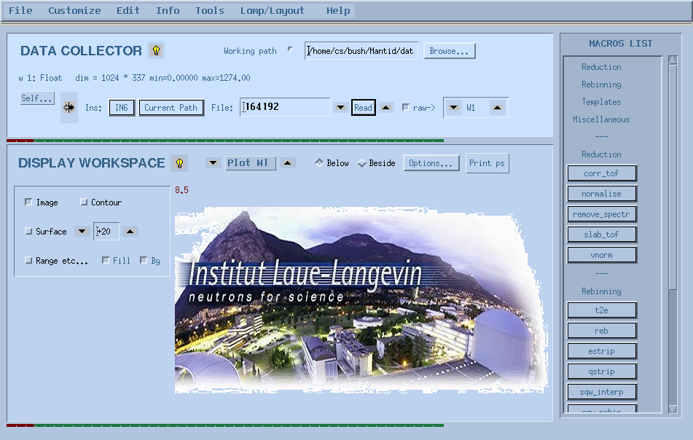
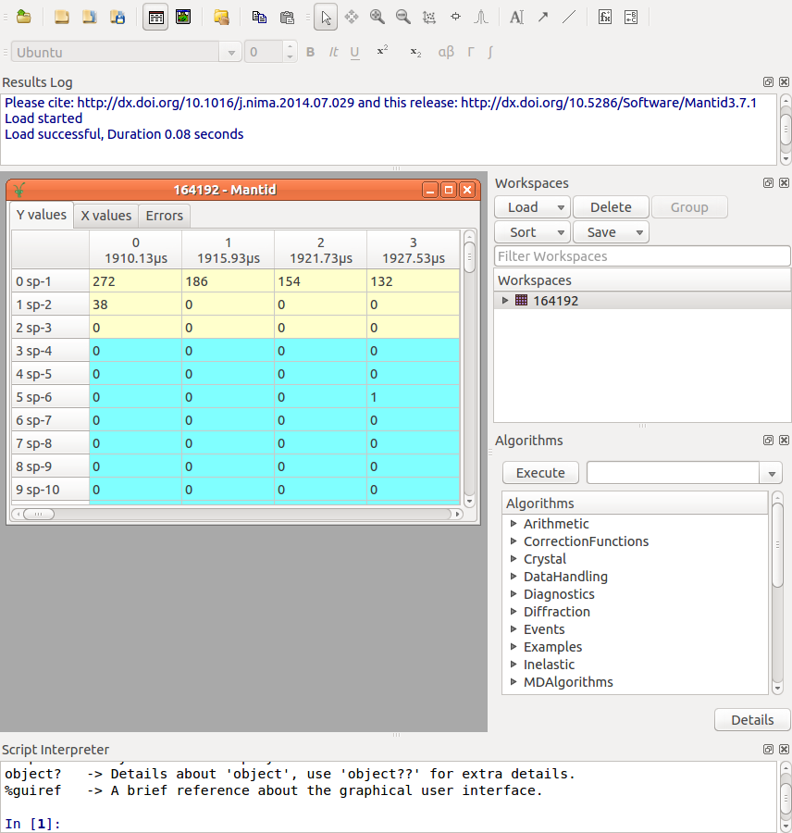
LAMP and Mantid
Workspaces
Notes:
Both have workspaces, for loading and manipulating data. The workspaces contain an in-memory store of the data counts for each detector spectrum, along with associated meta-data.

Slide 8
LAMP and Mantid
Algorithms
Notes:
… both have algorithms which act on the workspaces, in Lamp’s case they are called macros…

Slide 9
LAMP and Mantid
Plotting
Notes:
… both have plotting functionality…

Slide 10
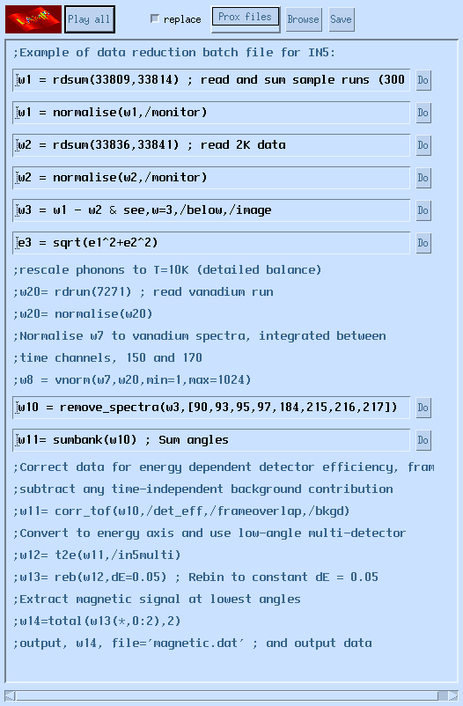
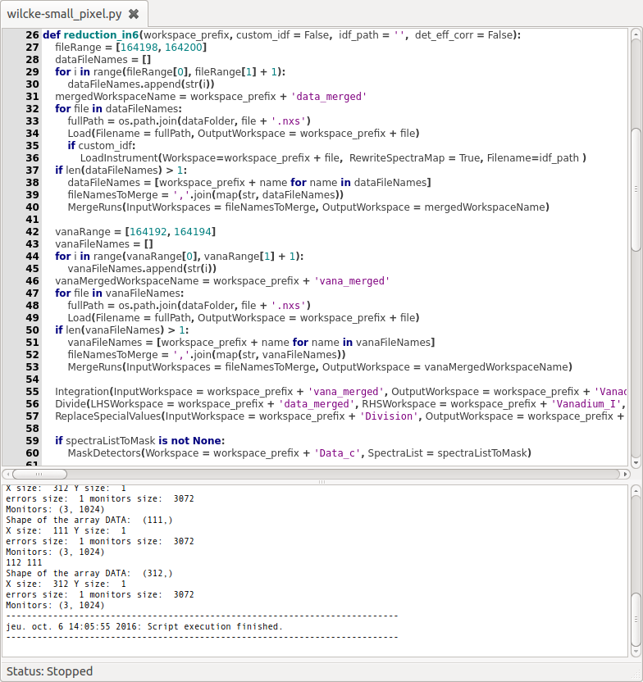
LAMP and Mantid
Scripting
Notes:
and both have scripting capabilities. One of the other advantages of switching to Mantid is that the scripting capability is in Python, which, as mentioned yesterday in the talk about Savu is more widely used in the scientific community than IDL.

Slide 11
ILL Workflows
Started with Time-of-Flight Spectrometry (IN4/5/6) and Backscattering instruments (IN16B)
Initial work started by:
Ricardo Ferraz-Leal (loaders, instrument definitions, sample scripts)
Spencer Howells and Elliot Oram (IN16B workflow)
Features to support workflows:
File loading and merging sample logs
Flat background moving window average
Incident energy calibration for ToF Instruments
Notes:
The first technique areas we looked at have been DG ToF spectroscopy and backscattering.
There was some initial work done for ILL in Mantid already. Ricardo Ferraz-Leal had worked on the loaders, IDFs and sample scripts (amongst other things).
Spencer Howells and Elliot Oram from ISIS had also done some work the IN16B workflow.
As well as starting work on the workflows themselves there are a number of features we worked on to support the workflows. For example file loading, the ILL NeXus files have no prefix so required some different treatment in Mantid for loading multiple files.
Then there are other algorithms, or changes to algorithms we implemented to replicate some functionality in Lamp, such as calculating the background using a moving average, and incident energy calibration for the direct geometry instruments. These are differing requirements from other institutions as the ILL is a reactor source, so the nature of things like the background are different.

Slide 12
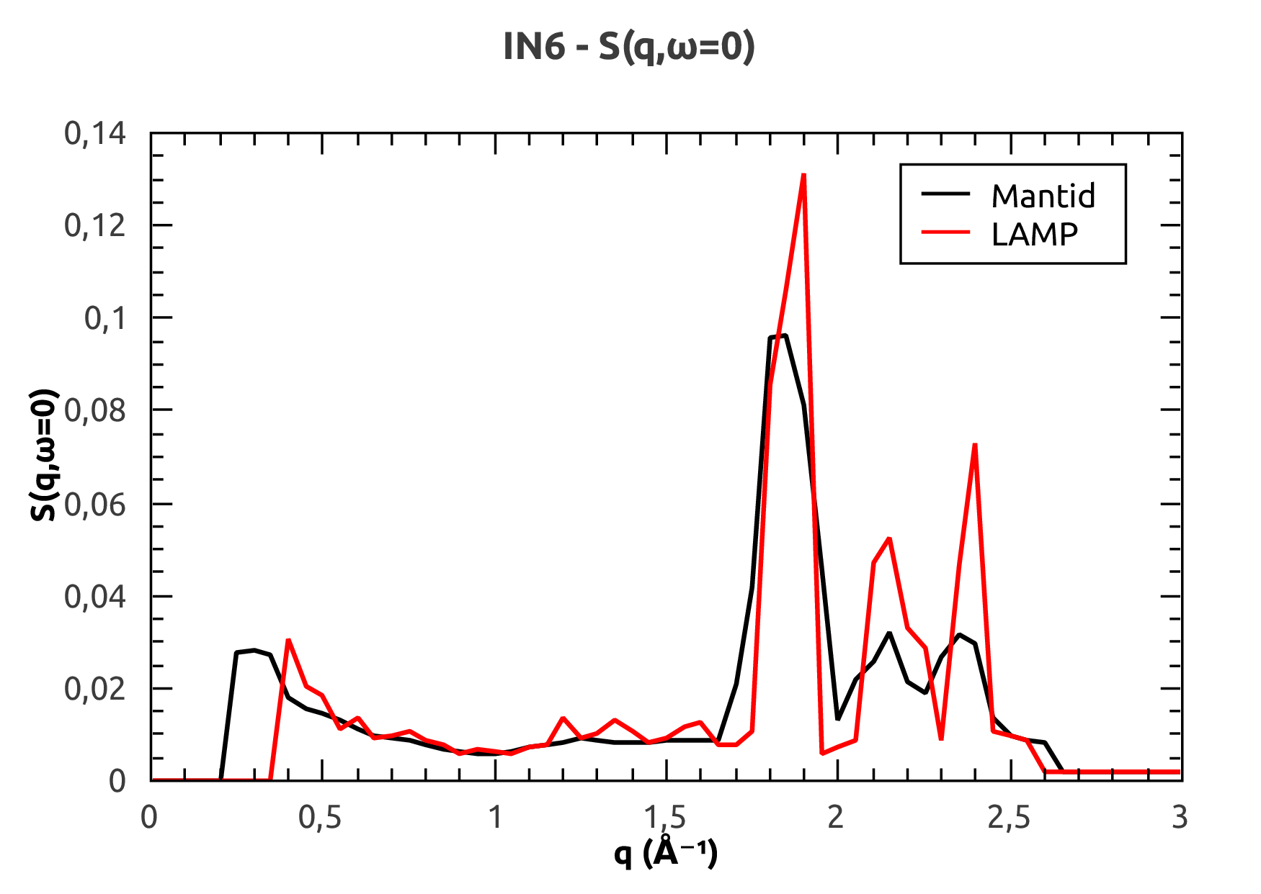
Time-of-Flight Workflow
Notes:
One of the first thing we looked at was the complete reduction. You can see in this plot sharper peaks in LAMP compared with Mantid.

Slide 13
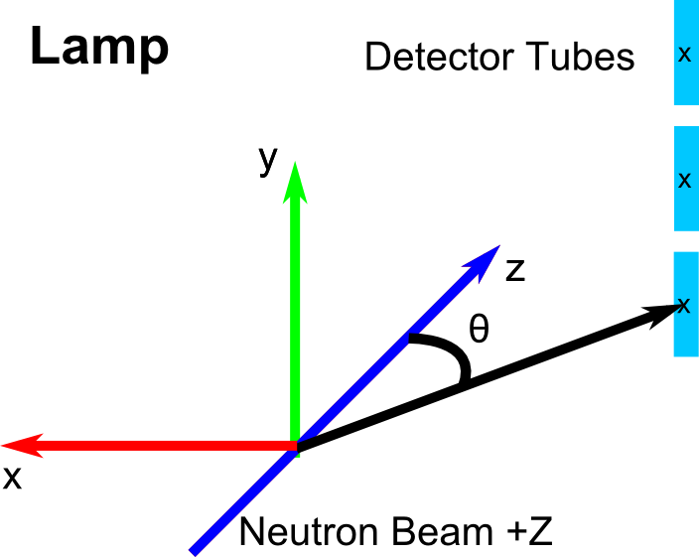
Time-of-Flight Workflow
Notes:
Which is to do with the way LAMP and Mantid handle this conversion. LAMP treats everything as point data…

Slide 14
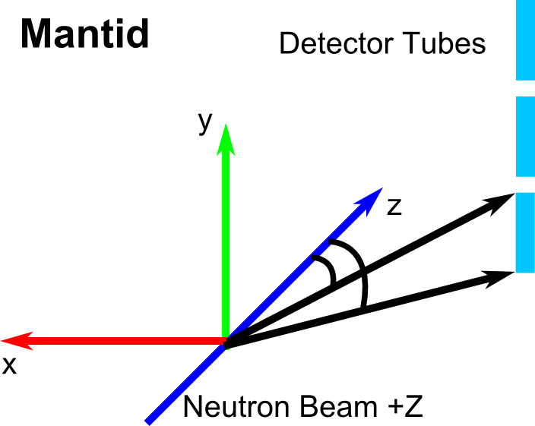
Time-of-Flight Workflow
Notes:
…while Mantid treats the full geometry.

Slide 15
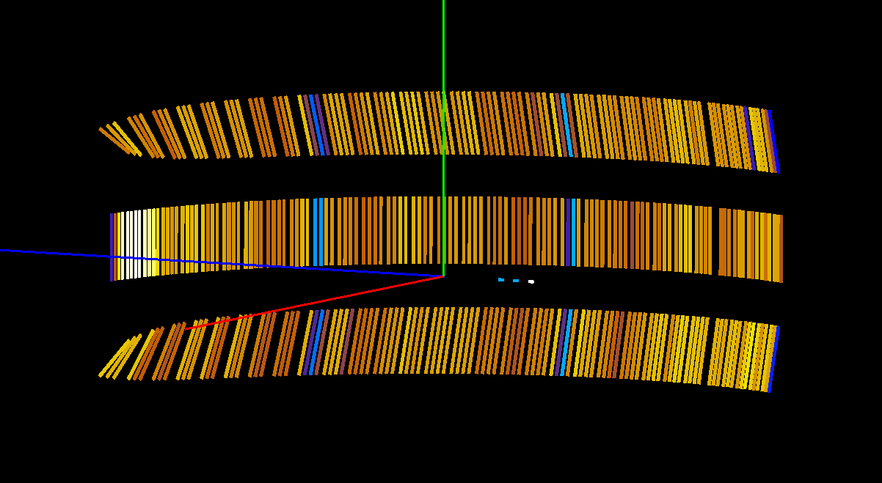
Time-of-Flight Workflow
Instrument Definition – IN6 Original

Slide 16
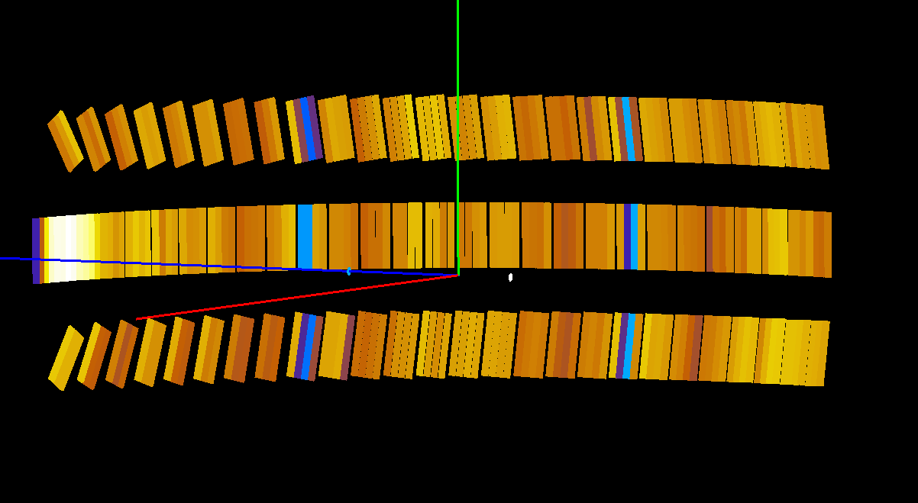
Time-of-Flight Workflow
Instrument Definition – IN6 Updated

Slide 17
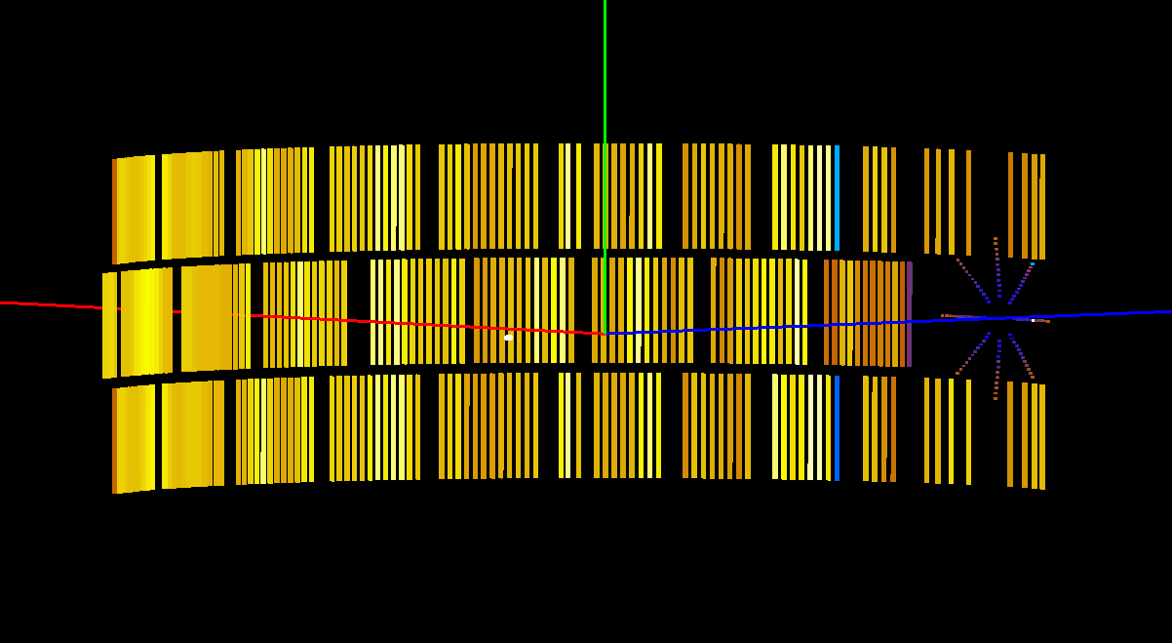
Time-of-Flight Workflow
Instrument Definition – IN4 Original
Notes:
This means getting the exact detector geometry for Mantid correct was important. It is difficult to get all the information needed about the instruments though, especially when they are 30 years old. This picture shows the old Mantid definition for IN4, and you can see these main detectors in groups. However, the upper and lower banks hsould be rotated so the detectors all have a similar angle to the incoming beam. The small angle detectors you can see here should also cover a small ring, but they have a shape a bit like a cylinder bent in the middle.

Slide 18
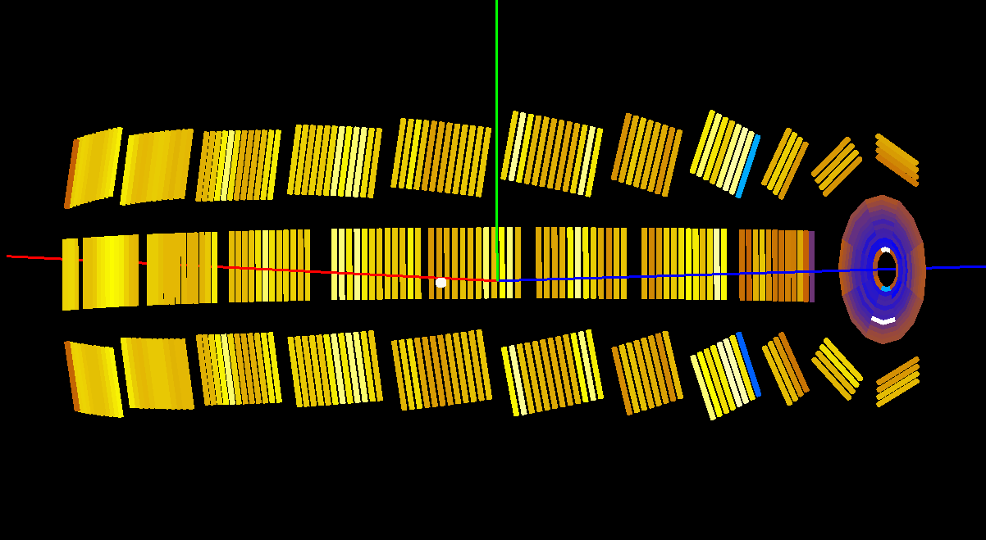
Time-of-Flight Workflow
Instrument Definition – IN4 Updated
Notes:
Here you can see the actual updates for IN4. The upper and lower banks are rotated correctly the tubes have the right length, and the small angle detectors have the right shape. Similar work was done for IN6.

Slide 19
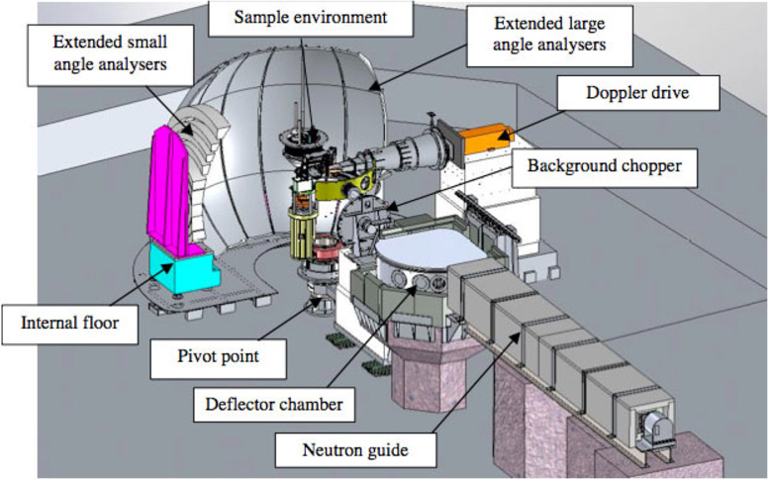
Backscattering Workflow – IN16B
Notes:
I will now say something about the backscattering workflow. IN16 is an indirect geometry instrument, and has a mono-chromator crystal on a Doppler drive. This results in two different parts to the resulting workspace corresponding to the forward and back motion of the Doppler drive.

Slide 20
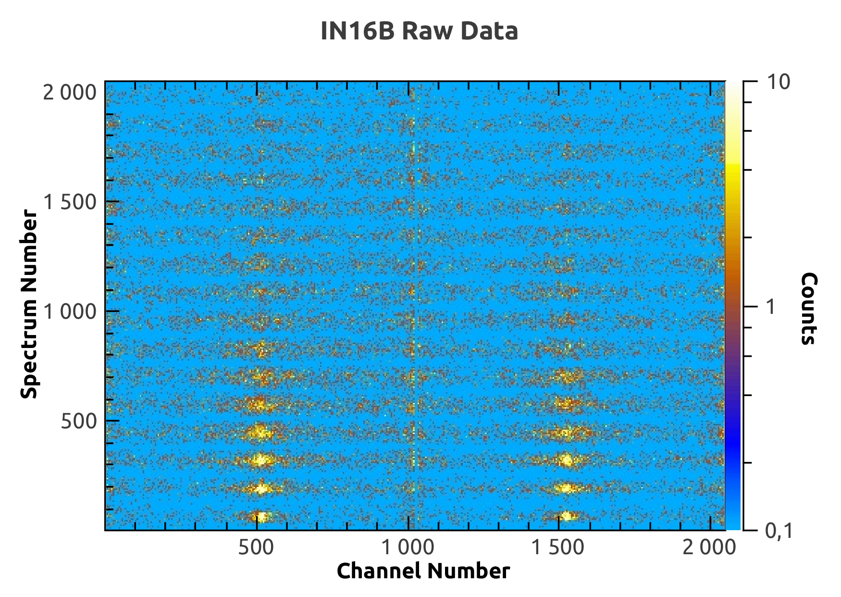
Backscattering Workflow – IN16B
Notes:
This shows the resulting workspace, you can see two elastic peaks, and a bit of a discontinuity in the middle.

Slide 21
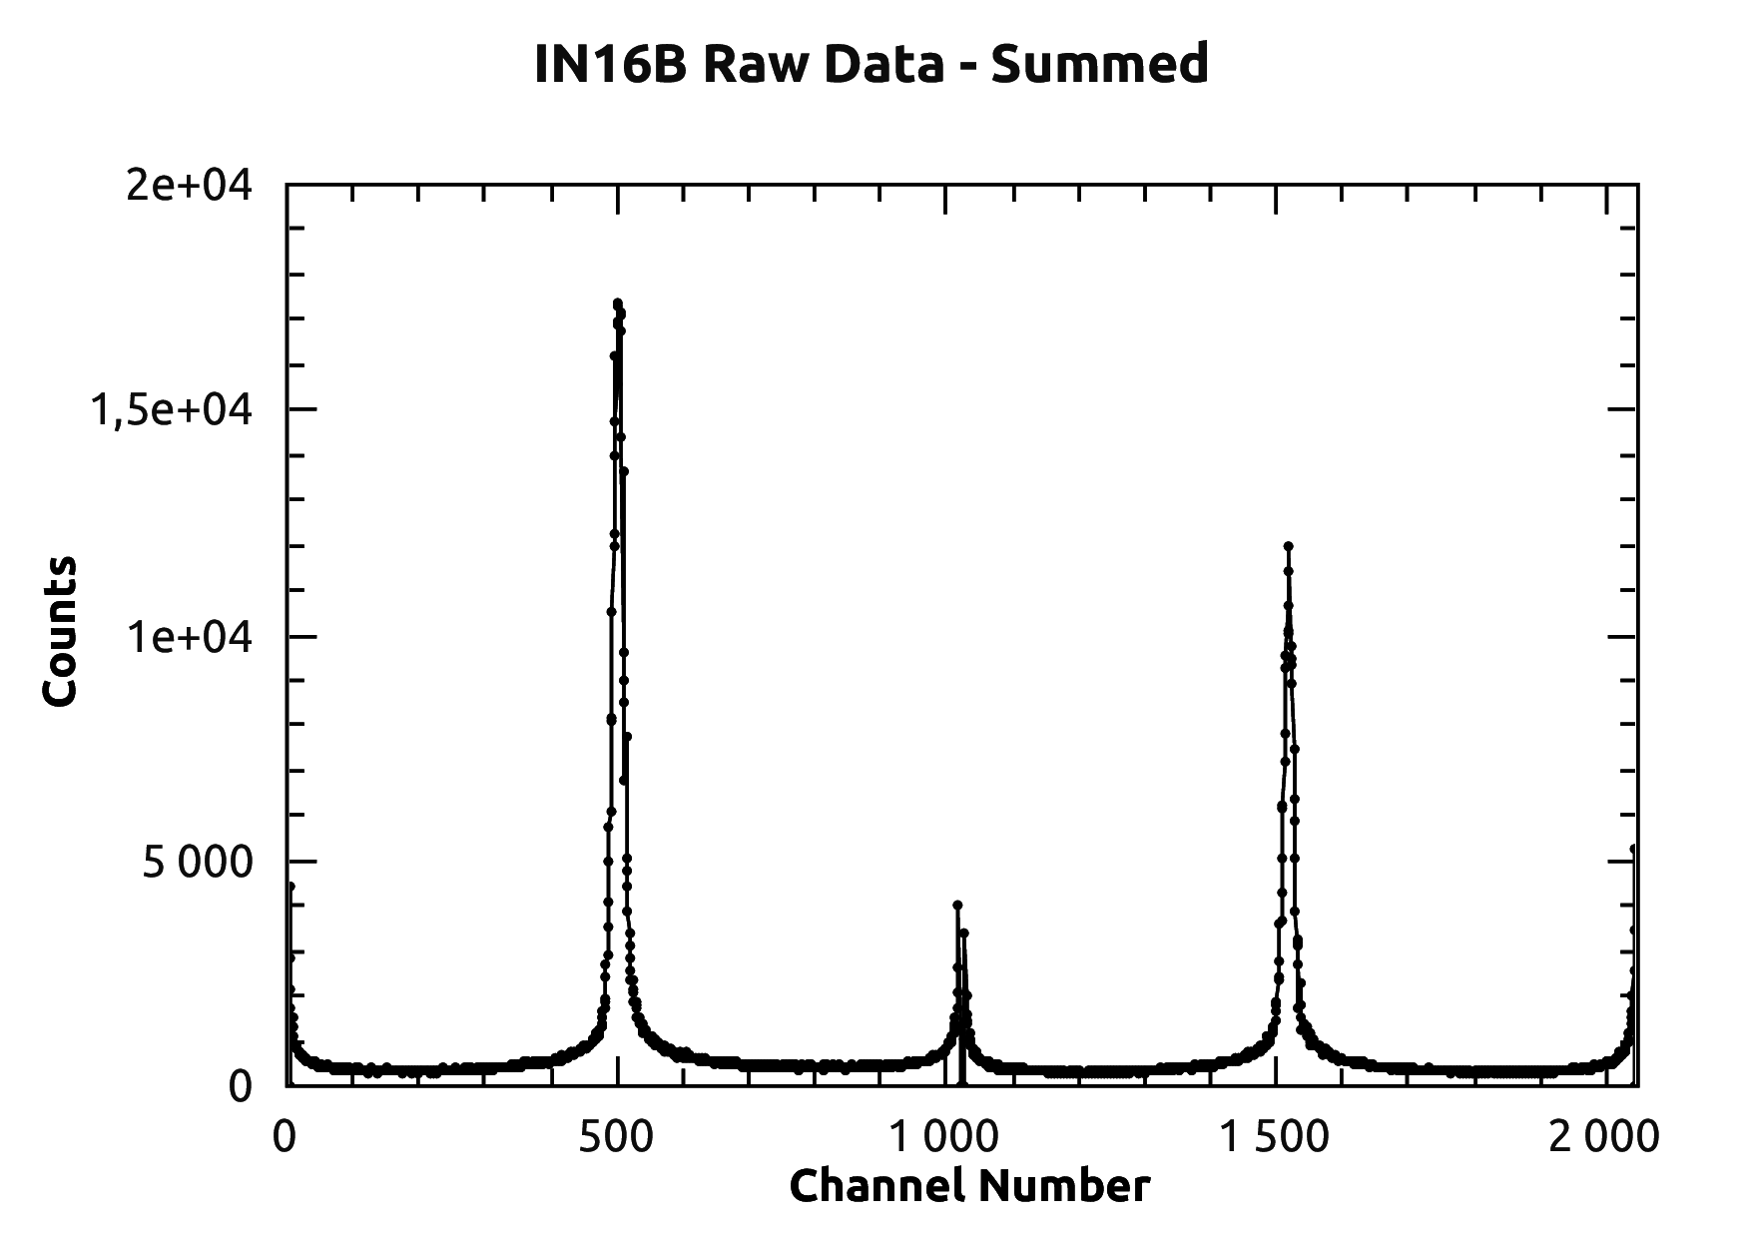
Backscattering Workflow
Elastic Peaks
Left Workspace
Right Workspace
Notes:
Summing these you can see the two workspaces, left and right, more clearly, alongside the elastic peaks. A significant piece of work here was to provide the 8 options that LAMP has to Mantid. Although there is just one users would want, due to some bad data sometimes from the instrument the instrument scientists would want to be able to select what they do with the two workspaces.

Slide 22
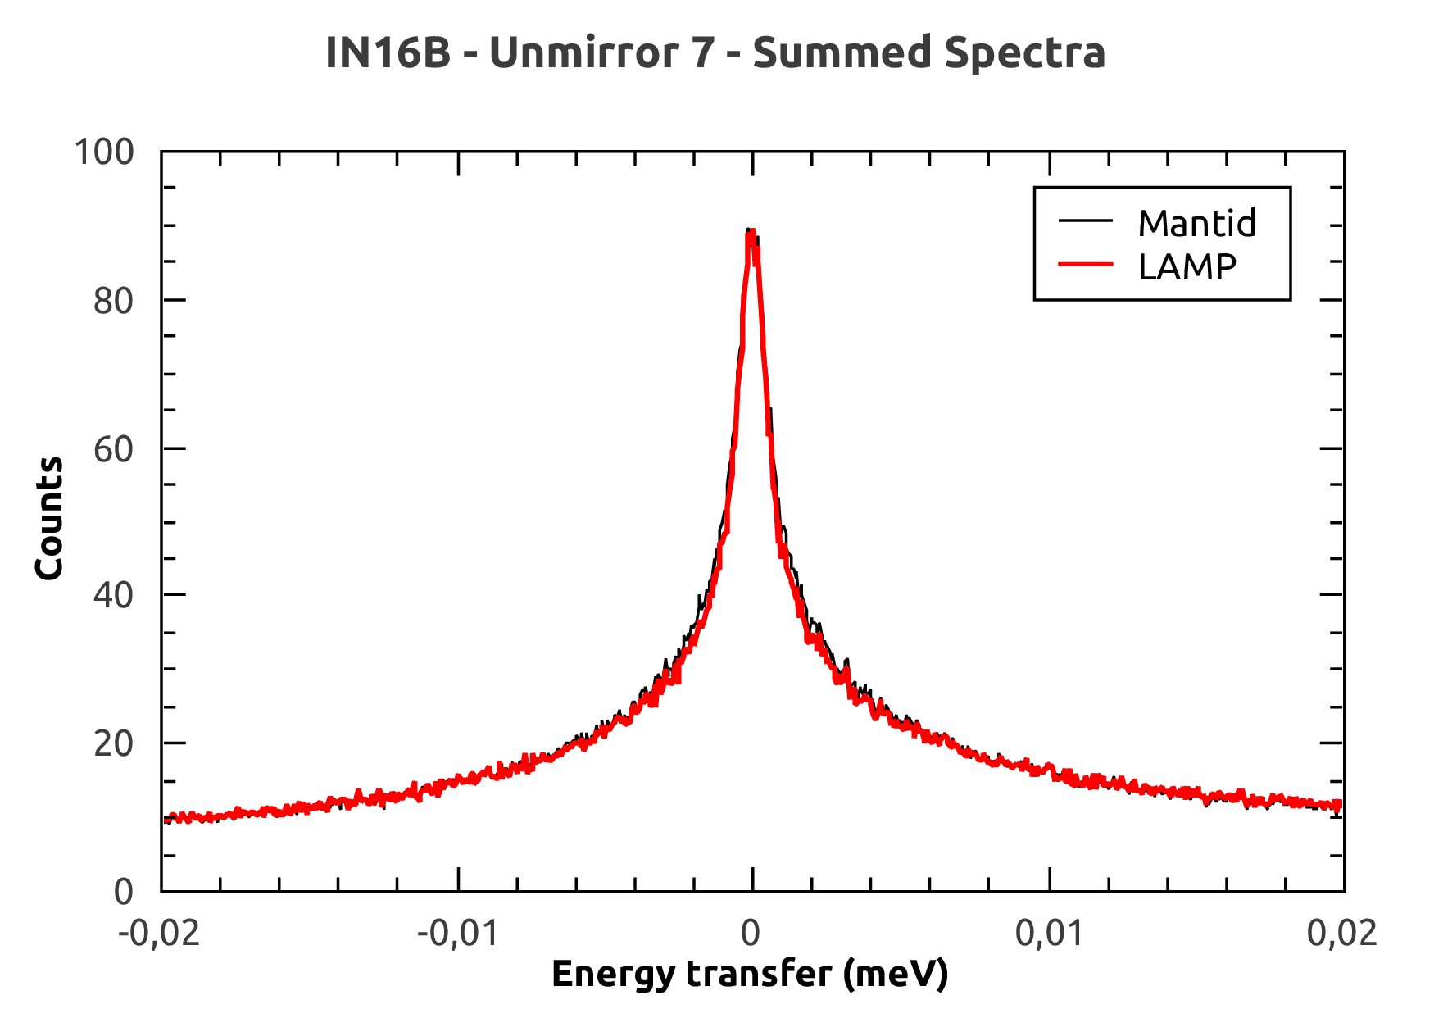
Backscattering Workflow – Lamp and Mantid
Notes:
In this unmirror case both the left and the right workspaces are centred on 0 and summed, but using the vanadium run to determine the peak positions.
Here you can see good agreement between LAMP and Mantid.

Slide 23
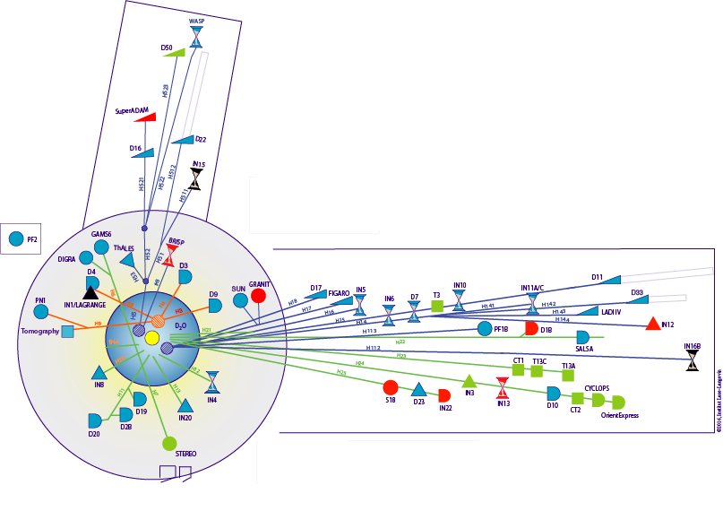
Future Work – ILL Instruments
Started on ToF and Backscattering…
…SANS…
…reflectometry…
…diffraction
SuperADAM
D22
FIGARO
D11
D17
IN5
D33
IN6
D4
IN16B
D1B
IN4
SALSA
D2B
D20
Notes:
As slide…

Slide 24
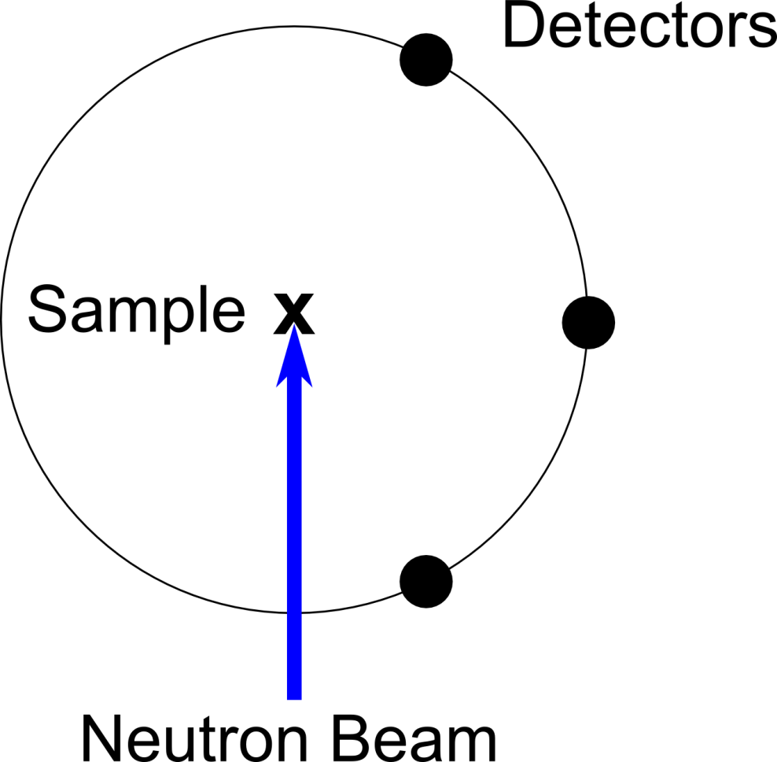
Future Work – Scanning Instruments
Support the instruments at ILL with movable detectors, such as D2B, D4, D7 and D16
D2B – Powder
Diffractometer
Notes:
Also mention TAS, not included in the Bastille project but implementation should bare them in mind.
In the case of D2B, a very high resolution powder diffractometer, there are 64 detectors, and these move through 100 steps to cover the entire range of angles between the detectors.

Slide 25
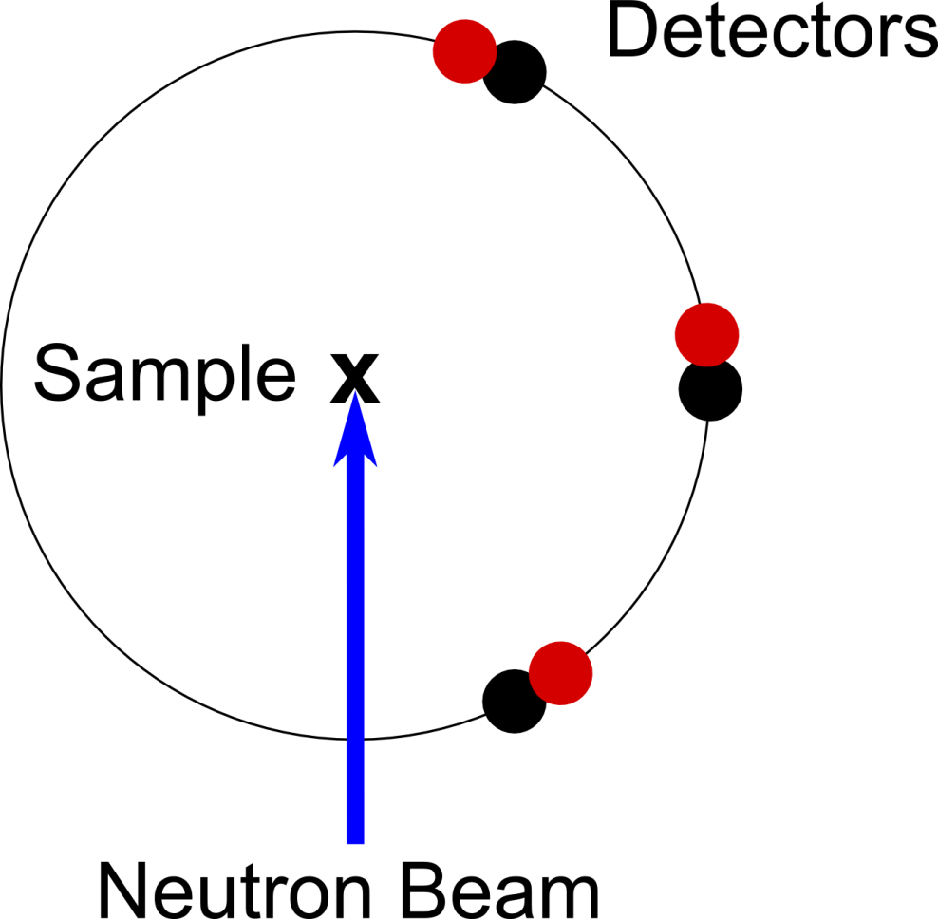
Future Work – Scanning Instruments
Support the instruments at ILL with movable detectors, such as D2B, D4, D7 and D16
D2B – Powder
Diffractometer

Slide 26
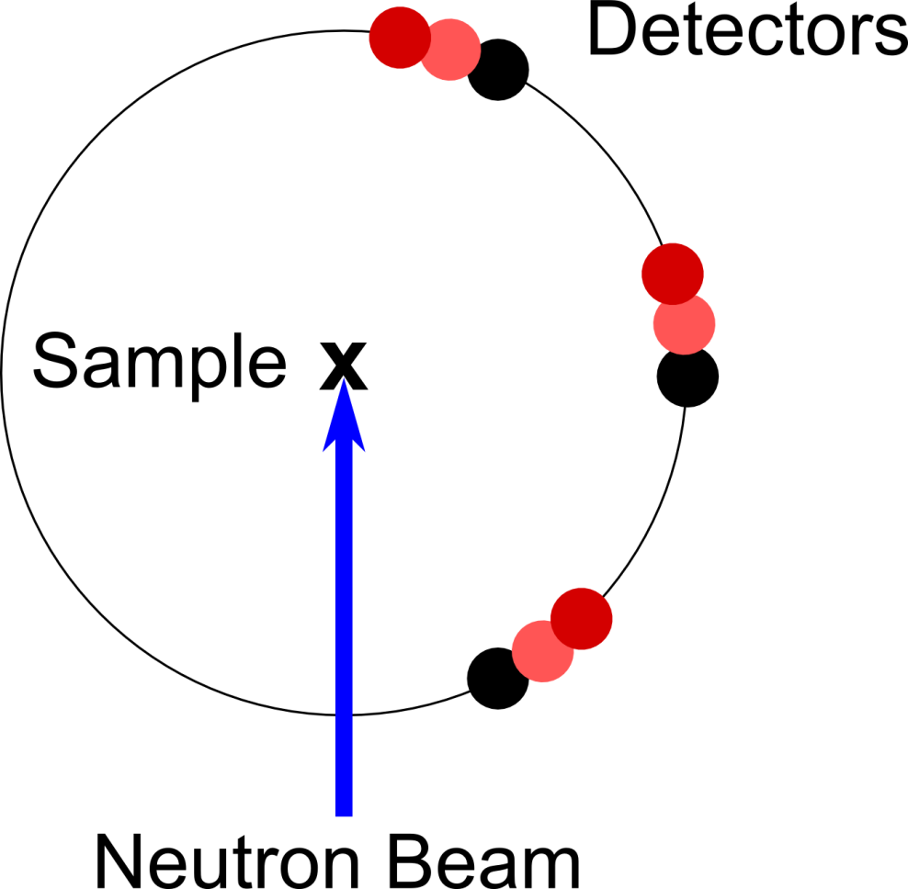
Future Work – Scanning Instruments
Support the instruments at ILL with movable detectors, such as D2B, D4, D7 and D16
D2B – Powder
Diffractometer

Slide 27
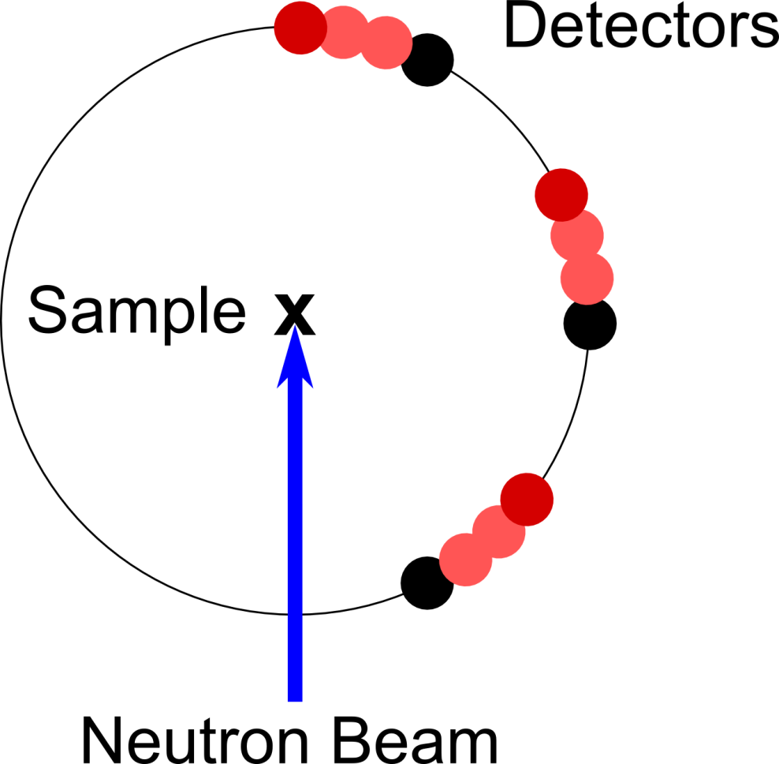
Future Work – Scanning Instruments
Support the instruments at ILL with movable detectors, such as D2B, D4, D7 and D16
D2B – Powder
Diffractometer
Notes:
This requires some framework changes to support properly, so that multiple spectra can be connected to a single detector, but with each spectrum still knowing where it was taken.

Slide 28
Future Work, Summary and Conclusions
SINE2020 funding for Mantid on continuous sources
SINE2020 funding for data analysis work:
QENS – GUIs, fitting and analysis in Mantid
Simulation – MDANSE, DFT
Mantid adoption well under way at the ILL…
… but still a long way to go
Thanks for listening!
Notes:
SINE2020 work for Mantid on continuous sources… some of this funding the project started already, but some more of it left.
SINE2020 projects for QENS, for GUI improvements, fitting and data analysis, within Mandtid, and for MDANSE and DFT work.
So I have talked about the Bastille project for Mantid at the ILL, and introduced some of the work we have done to support certain workflows. So Mantid adoption is well under way, but I from the future work I talked about you can see there is still plenty of work ahead of us too.

